Slide 1
Current Developments in Spectrum Management
Markus Dreis
RFI 2025 Online Workshop, 21 October 2025

Slide 2
Introduction
The need of today’s society for global connectivity, ever increasing information demand, and the precise exploration of the Earth and beyond requires developing and maintaining an appropriate regulatory framework to ensure that all those needs can be facilitated without mutually interfering with each other.
This keynote attempts at providing an overview on some of the current developments in spectrum management and their challenges facilitating such new use whilst avoiding/minimising the impact on existing users/services of the same/adjacent spectrum:
Large (mega) constellations of non-geostationary satellite systems,
Expansion of use and applications of satellite services within existing satellite allocations,
General trend by active service to also use higher frequency bands (above 71 GHz) – scientific (passive) services will no longer be alone up there,
Additional (rather compensatory) spectrum for Sea Surface Temperature (SST) measurements,
Additional spectrum identification for IMT (WRC-27 Agenda Item 1.7) in the bands 4400-4800 MHz and 7125-8400 MHz (or parts thereof), and 14.8-15.35 GHz,
New Mobile Satellite Service (MSS) allocations/applications,
Race to the Moon requires dedicated spectrum.

Slide 3
Developments in spectrum management & use – where/how to observe?
Developments in radio frequency spectrum use and regulations are best observed and managed when following the three basic levels, i.e. ITU-R, regional and national level !!!
ITU-R:
in its “ordinary” work based on Study Questions and individual contributions (even when not necessarily related to a Question) from sector members and member countries on whatever topic under the responsibility of the six Study Groups and their Working Parties;
in preparation for World Radiocommunication Conferences (WRCs) which updates in a four-year cycle the Radio Regulations, an international treaty among ITU member states to govern the use of the radio spectrum and satellite orbits.
Regional groups:
where a group of countries harmonise their regulations and agree on common positions/proposals in preparation for WRCs.
Individual country:
with their national regulatory authorities.
Reason why to follow the work and processes on all three levels is that any new frequency spectrum user is seeking:
regulatory certainty through a stable and predictable regulatory environment, at all three levels;
spectrum harmonisation for economies of scale and equipment interoperability;
protection of existing services through appropriate regulatory provisions to ensure compatibility and sharing among service.
→ Spectrum users that do not spent the effort to participate and contribute at all three levels will not be able to influence the regulatory framework. This is of particular importance for the highly sensitive services like Radioastronomy (RAS) or the Earth Exploration Satellite Service (EESS) (passive) when it concerns to protection.

Slide 4
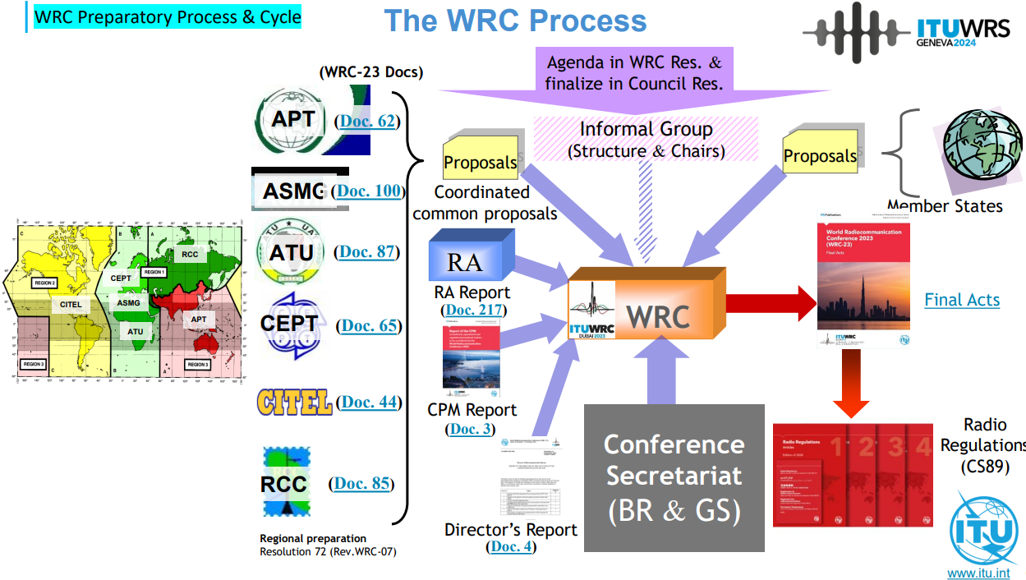
Developments in spectrum management & use – WRC-Process

Slide 5
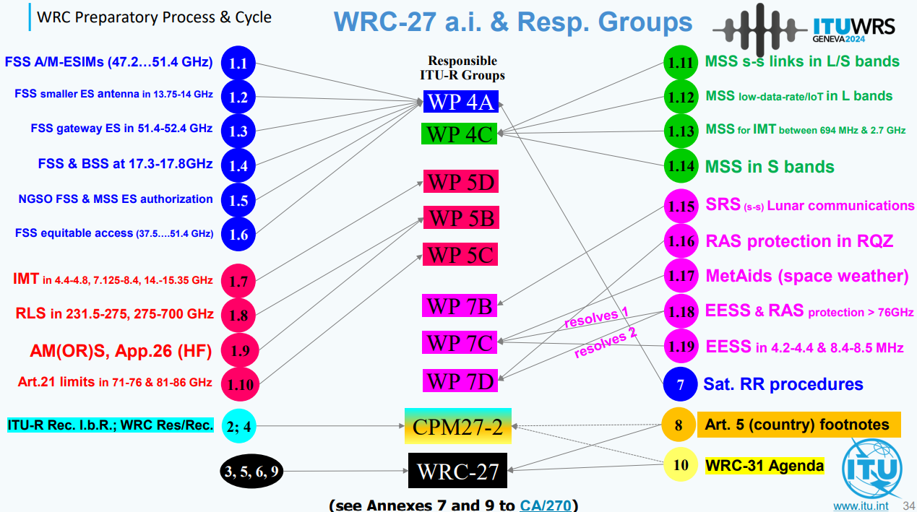
WRC-27 Agenda – Responsible and contributing ITU-R groups
Contributing
Contributing
7C
7D
7B
7C
7D
7B
7C
7B
7C
7D
7C
7D
7B
7C
7D
7C
7B
Responsible
7C
7D
7B
7C
7D
7B
7C
7D
7B
7D
7C
7D
7B
7C
7D

Slide 6
Developments in spectrum management & use – trends (1)
Large (mega) constellations of non-geostationary satellite systems
Skyrocketing number of filings for large constellations of non-geostationary satellite systems;
Recent Space Sustainability Forum (7-8 Oct, Geneva) talked about 1.8 million satellites in ITU filings by 2030;
RFI challenges related to wanted emissions, unwanted emissions and unintended electromagnetic radiation from satellites (UEMR).
Huge issue for RAS in numerous frequency bands (even in much larger frequency ranges than those currently allocated to the RAS);
WRC-27 Agenda Item 1.16 attempts finding mechanisms to protect RAS;
Assessing the single-entry and aggregate impact of NGSO FSS in the several bands listed in Annex 1 to Resolution 681 (WRC-23);
Recognition of Radio Quiet Zones (RQZ)
Discussion: Recognition/protection strictly within the bands allocated to RAS vs. larger bandwidth observed;
Res 681 explicitly only mentions two RAS facilities in considering k) for a possible RQZ recognition in the RR, leaving no room for extending the scope to other sites.

Slide 7
Developments in spectrum management & use – trends (2)
Expansion of use and applications of satellite services within existing satellite allocations
WRC-27 Agenda Items 1.1 (FSS aeronautical and maritime ESIMs in the 47.2-50.2 GHz and 50.4-51.4 GHz bands) & 1.3 (FSS gateways in the 51.4-52.4 GHz band transmitting to non-GSO systems;
Are the already established unwanted emission limits in the RR Resolution 750 still appropriate to protect the 50.3 GHz and 52.7 GHz passive sensing bands from these additional applications?
Studies in WP7C regarding the possible impact of NGSO FSS (with an apogee lower than 20 000 km) on EESS (passive) sensors in the band 18.6-18.8 GHz;
Radio Regulations footnote 5.522B (WRC-2000) limits the use of the band 18.6-18.8 GHz by the FSS to geostationary systems and systems with an orbit of apogee greater than 20 000 km.
Will the satellite industry attempt to initiate a future WRC agenda item with the aim to modify the Radio Regulations to allow such use?
Regarding the band 18.6-18.8 GHz there is still an ongoing assessment of the RFI potential from GSO FSS due to reflections from large bodies of water into EESS (passive) sensors.

Slide 8
Developments in spectrum management & use – trends (3)
General trend by active service to also use higher frequency bands (above 71 GHz) – scientific (passive) services will no longer be alone up there!
Opportunity: WRC-27 Agenda Item 1.18 attempts at implementing relevant unwanted emission limits to protect RAS and EESS (passive) in a number of bands subject to RR footnote 5.340 (all emissions are prohibited) or subject to RR footnote 5.149 (RAS) (76-81 GHz, 130-134 GHz), ahead of the deployment by allocated active services;
First temporary licenses for a satellite constellation using the bands 71-76 GHz and 81-86 GHz for NGSO gateway earth stations already issued in individual countries, requiring the establishment of appropriate unwanted emission limits in the RR Res 750 to protect the RR footnote 5.340 band 86-92 GHz and also measures to protect RAS in the bands 76-86 GHz and 92-94 GHz, both subject to RR footnote 5.149.
Radiolocation services in bands above 231.5 GHz (WRC-27 Agenda Item 1.8);
So far, potential applications avoid frequency overlap with EESS (passive);
Nevertheless, some potential automotive applications in adjacent bands, due to their high number of devices, could cause aggregated unwanted emissions that would exceed the protection criteria for EESS (passive) and thus would require the establishment of appropriate limits in the Radio Regulations.
Preliminary WRC-31 agenda item 2.1 (Extension of the frequency allocation table from 275 GHz to 325 GHz) and agenda item 2.6 (IMT (6G) in bands between 102 and 275 GHz).

Slide 9
Developments in spectrum management & use – trends (4)
Additional (rather compensatory) spectrum for Sea Surface Temperature (SST) measurements
Opportunity: WRC-27 Agenda Item 1.19 aims at new frequency allocations for EESS (passive) in the bands 4.2-4.4 GHz and 8.4-8.5 GHz (on a non-protection basis);
Compensation for the degraded usability and quality of the SST measurement data in the 6/7 GHz range due to the IMT identification in that range at WRC-23;
Vision: Future multichannel instruments utilising all three bands for SST measurements.
Some potential negative impacts on these potential new allocations to EESS (passive) for SST measurements in the bands 4200-4400 MHz and 8400-8500 MHz from potential IMT identification under WRC-27 agenda item 1.7.

Slide 10
Developments in spectrum management & use – trends (5)
Additional spectrum identification for IMT (WRC-27 Agenda Item 1.7) in the bands 4400-4800 MHz and 7125-8400 MHz (or parts thereof), and 14.8-15.35 GHz
Some potential negative impacts on the potential new allocations to EESS (passive) for SST measurements in the bands 4200-4400 MHz and 8400-8500 MHz from potential IMT identification in neighbouring bands.
Discussions ongoing in ITU-R whether or not to consider studies on the potential for RFI from the Space Research Service (Earth-to-space) in 7145-7190 MHz (deep space) and 7190-7235 MHz (near-Earth) uplinks into IMT;
This would result in large separation distances to protect IMT which in turn could result in future negative impacts to the operation of SRS Earth stations.
Experience: National regulators give priority for IMT over SRS Earth station deployments.
Studies on required separation distances to protect EESS and MetSat Earth stations in various bands (7450-7550 MHz, 7750-7900 MHz and 8025-8400 MHz);
Numbers currently range from 1-5km to 200km, depending on the assumptions used (and the authors);
Regulatory conditions to protect existing services such as RAS, EESS (passive) or receiving Earth stations of data from EESS and MetSat satellites are not very much appreciated as they devalue the spectrum to be auctioned.
Result: No protection is granted to EESS and MetSat receiving Earth stations.
The band 15.35-15.4 GHz is subject to RR footnote 5.340 (all emissions are prohibited) and thus used by RAS worldwide.
Mechanism: Unwanted emissions to be limited to comply with RAS protection requirements (Rec ITU-R RA 769).

Slide 11
Developments in spectrum management & use – trends (6)
New Mobile Satellite Service (MSS) allocations/applications
Direct connectivity between space stations and IMT User Equipment (UE) in the frequency range 694-2700 MHz (WRC-27 Agenda Item 1.13);
Identification of a list of 15 frequency band pairs in the uplink and downlink for MSS direct communication with IMT UE;
5 bands in overlap with other WRC-27 agenda items on MSS (1.12 and 1.14) adding complexity;
Potential impact from direct to cell transmissions on RAS up to 4th and 5th harmonics;
One uplink frequency under consideration is at 1427-1470 MHz which is adjacent to the band 1400-1427 MHz, subject to RR footnote 5.340 (all emissions prohibited). The same applies to agenda item 1.12.
Mechanism: Protection to be ensured through mandatory unwanted emission limits in Res. 750.
MSS in the 1427-1432 MHz, 1645.5-1646.5 MHz, 1880-1920 MHz and 2010-2025 MHz bands for low data rate non-GSO systems (WRC-27 Agenda Item 1.12).
MSS in the bands 2 010-2 025 MHz, 2120-2160 MHz and 2 160-2 170 MHz (WRC-27 Agenda Item 1.14).

Slide 12
Developments in spectrum management & use – trends (7)
Race to the Moon requires dedicated spectrum
Lunar surface communications and with lunar orbits (WRC-27 Agenda Item 1.15);
Resolution 680 (WRC-23) calls for studies on systems in the Space Research Service (SRS) which may operate on the lunar surface, or systems in lunar orbit communicating with systems on the lunar surface, in the following frequency ranges or portions thereof:
390-406.1 MHz, 420-430 MHz and 440-450 MHz, limited to outside the shielded zone of the Moon (SZM);
2400-2690 MHz, 3500-3800 MHz, 5150-5570 MHz, 5570-5725 MHz, 5775-5925 MHz, 7190-7235 MHz, 8450-8500 MHz and 25.25-28.35 GHz.
The Shielded Zone of the Moon (SZM) is a unique radio quiet environment for radioastronomical research and other passive applications, subject to RR No. 22.22-22.25 (Do these provisions leave room for interpretation?);
In particular, the frequency range below 2 GHz has to be kept free from interference into the RAS. Of interest to the RAS in the short term are frequency bands below 50 MHz, since many planned space missions concentrate on that frequency range;
Protection of RAS in the Shielded Zone of the Moon (SZM);
Mechanism: Appropriate thresholds for harmful interference to protect RAS operating in the SZM remain to be determined.

Slide 13
Summary
Large (mega) constellations of non-geostationary satellite systems and in general the huge increase in NGSO satellites already today and in the coming years bear significant challenges and RFI.
Expansion of use and applications of satellite services within existing satellite allocations require appropriate regulations to avoid RFI (WRC-27 AIs 1.1 and 1.3).
General trend by active services to also use higher frequency bands require appropriate regulation to avoid RFI (WRC-27 AIs 1.8 and 1.18).
For future Sea Surface Temperature (SST) measurements, there is a chance to compensate for the degraded usability in the 6/7 GHz range by adding allocations in the bands 4.2-4.4 GHz and 8.4-8.5 GHz.
Potential negative impacts particularly on MetSat and EESS Earth stations, if WRC-27 would agree on an IMT identification in the band 7125-8400 MHz (WRC-27 Agenda Item 1.7).
New Mobile Satellite Service (MSS) allocations/applications, particularly direct connectivity between space stations and IMT User Equipment in the frequency range 694-2700 MHz (WRC-27 Agenda Item 1.13), could cause some issues.
The race to the Moon requires the development of the appropriate regulatory environment to ensure the protection of RAS on the SZM (WRC-27 Agenda Item 1.15).

